Slide 1
Introduction to Mark’s Gospel
“For even the Son of Man did not come to be served, but to serve, and to give his life as a ransom for many” (Mark 10:45)

Slide 2
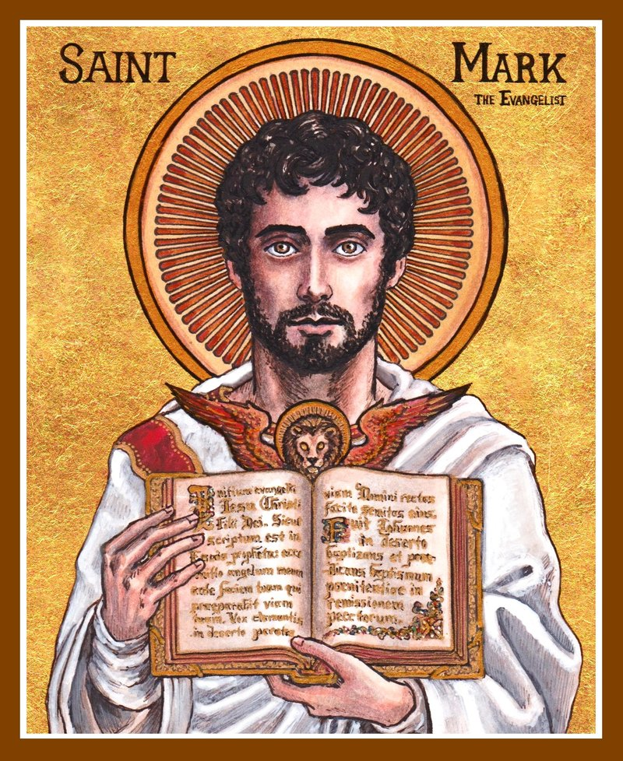
Author
Mark (early church fathers tell us that he dictated this account from Peter)
Mark was not one of the Twelve, but he was probably the young man who fled naked when Jesus was arrested (14:51,52); as a teenager he hung around Jesus and his disciples
Mark’s mother Mary used her house to host Jesus’ followers (Ac12:12); he is called “John, also called Mark” (Ac12:12,25; 15:37), and was the cousin of Barnabas (Col4:10)

Slide 3
Author
Mark joined Paul and Barnabas on their first missionary journey as their helper (Ac12:25; 13:5), but when things got hard he deserted them and went home (Ac13:13; 15:37,38); at the start of their second journey Paul and Barnabas disagreed so sharply about him that they split up (Ac15:36-39)
Near death, Paul asked for Mark to come and help him (2Ti4:11); by this time he had written Mark’s Gospel and had changed

Slide 4
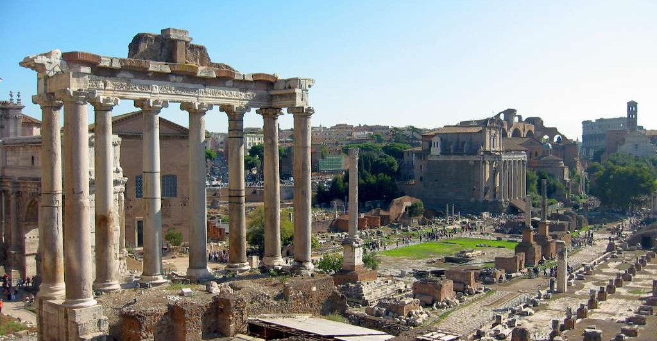
Date & Place of writing
Rome, probably about AD 55

Slide 5
Audience
Christians in Rome
Many were Gentiles, not Jews
So Mark’s Gospel explains Jewish traditions (e.g. 7:3,19; 14:12) and translates Aramaic expressions (e.g. 5:41; 7:34; 10:46)
These people were facing persecution
So Mark’s Gospel emphasizes the secrecy of Jesus’ identity
It also emphasizes the cost of identifying with Jesus and following him, and the suffering involved

Slide 6
Characteristics
Mark’s Gospel is basically a biography of Jesus
It was meant to be read out loud to a group of people
It is full of short, vivid, factual stories and prefers to use present-tense, action verbs
These forms would help people remember
He likes to use words like “at once,” “immediately” and “without delay”
The narrative contains tension, parallel scenes and paradoxes that draw the listener in
It has only two long teachings of Jesus, chapter 4 and chapter 13

Slide 7
outline
Mark’s Gospel has three basic sections:
Jesus’ ministry in Galilee (1:1-8:26)
Jesus’ ministry on his final journey to Jerusalem (8:27-10:52)
Jesus’ last week in Jerusalem (11:1-16:20)

Slide 8
Theme: Who is Jesus, really?
His identity is revealed incrementally (e.g. 1:24,27,34; 2:7; 3:11; 4:41; 7:37; 8:27-29; 14:61,62)
Especially, what Jesus came to do is gradually revealed (e.g. 1:8; 8:31; 10:45)
Paradox: Jesus the Son of God is the suffering servant

Slide 9
Theme: What does it mean to follow Jesus, really?
From the beginning the disciples are an integral part of the story
They are always watching, learning, reacting, being molded
Jesus focuses on training them
They fail to understand his mission and kingdom values
Through their examples, good and bad, we learn what it means to truly follow Jesus

Slide 10
Theme: the kingdom of God
It’s Jesus’ main message from the beginning (1:15)
It’s the man thrust of all his parables and teaching (4:1-34)
It’s something we experience partially now (9:1) and will experience fully in the future (14:25)
It teaches us new values (10:14,15) and a radical new allegiance (9:47)
Jesus would die and rise again to open the way for anyone who repents and believes to enter the kingdom of God

